Slide 1
Creating Equal Baseball Leagues Using a Genetic Algorithm
Noah Lindsley | Capstone Presentation 2023

Slide 2
My Project Description

Slide 3
Overview
Genetic Algorithms can be used to create evenly matched baseball teams.
My goal is to create generations of leagues and compare their uniformity until very close to equal.
In this application, multiple baseball teams will be randomly created and place into leagues, where the overall fitness of the leagues will be evaluated from generation to generation.

Slide 4
Requirements
Generate a pool of players, each having an ID, a list of possible positions, and a value(s) (consider ERA, HR, batting average, etc).
Each generated team must have enough players of correct type to play each position.
Use a genetic algorithm to find the best partition of players into teams.
Display the state of good fit genomes with appropriate statistics that show progress toward the goal.
The system should allow modification of parameters (number of teams, size of a team, distribution of players in a team), operators, and probabilities.
Explore various ways to measure the balance of the league.
Save the best from some number of iterations.

Slide 5
My Solution

Slide 6
Genetic Algorithm Explained
The general idea of a genetic algorithm is to simulate the process of evolution by applying natural selection, mutation, and crossover to a population of candidate solutions. The population evolves over time, with the most fit individuals surviving and passing their genetic information on to the next generation.
Notes:
Through the repetitive process of selection, crossover, and mutation, genetic algorithms can create very high-quality solutions to complex problems. They have been successfully applied to a wide range of fields, including engineering, finance, artificial intelligence and today, baseball.

Slide 7
Background Information
To place a value to each player in my simulation, I chose to use the baseball statistic known as W.A.R. (Wins Above Replacement).
W.A.R. measures a player's value in all areas of the game by calculating how many more wins he's worth than a replacement-level player at his same position (e.g., a Minor League replacement or a readily available free agent).
A team’s value, therefore, is simply the sum of each player’s W.A.R. on that team.

Slide 8
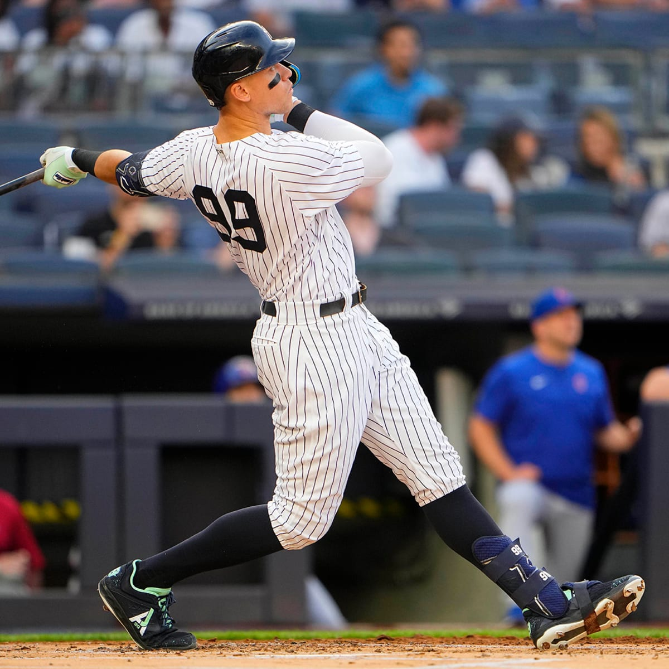
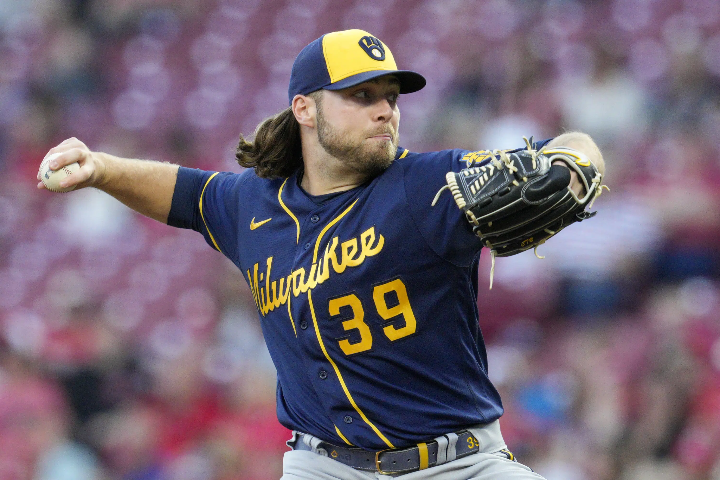
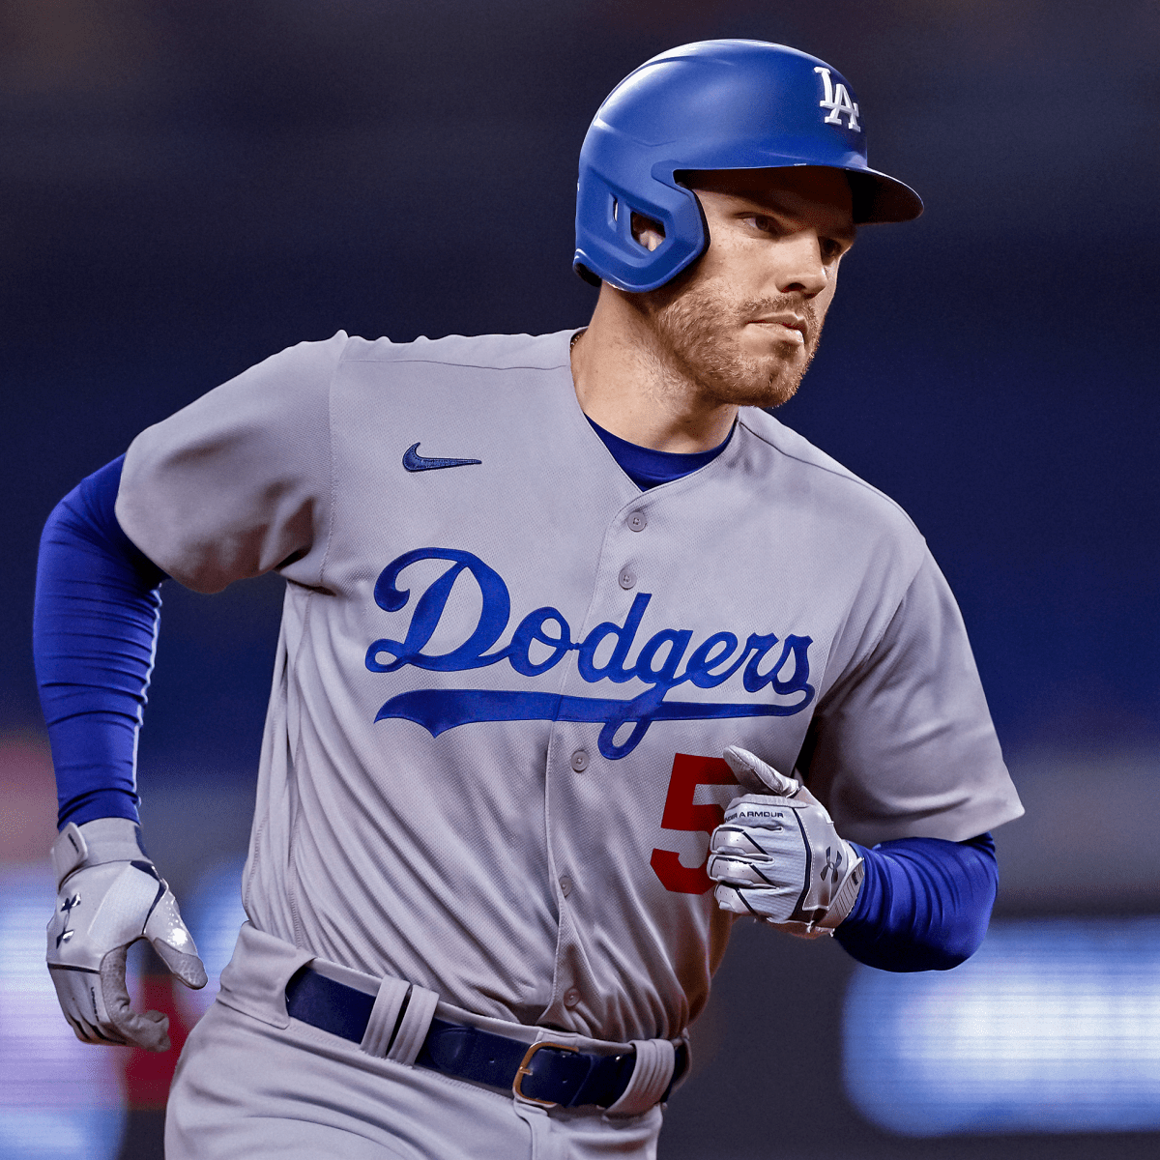
Examples of Different Player’s W.A.R. Statistic
Aaron Judge - 11.4
Corbin Burnes - 4.6
Freddie Freeman - 7.1

Slide 9
Background Information
When coming up with the fitness function for my genetic algorithm, I chose to use the difference of each team’s value in a league.
I chose to use difference between the different team’s value (Highest team W.A.R. - Lowest team W.A.R.) when comparing the evenness of leagues because it directly shows how even or far from even the leagues are.
I will call each league’s difference their league score (want a low score).
Notes:
For instance, having a league difference of 1 would indicate that all teams in that particular league have about the same total team W.A.R. amongst the players.

Slide 10
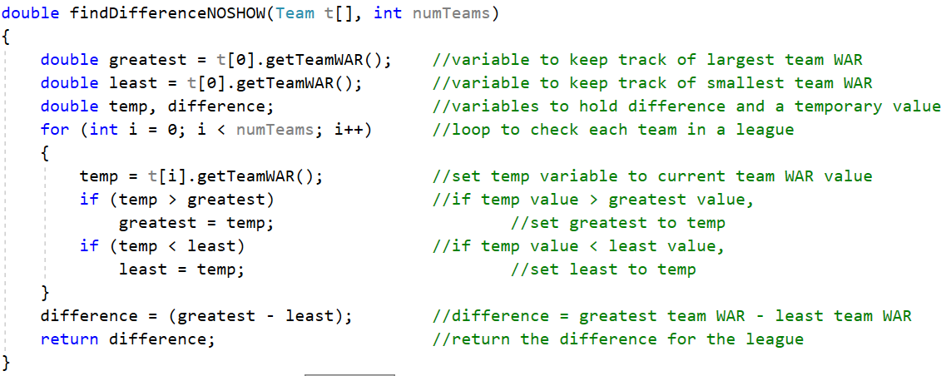

Slide 11
My Algorithm Step by Step

Slide 12
Initialization
A various number of leagues are randomly generated, each league containing 16 teams with 17 players on each of those teams.

Slide 13
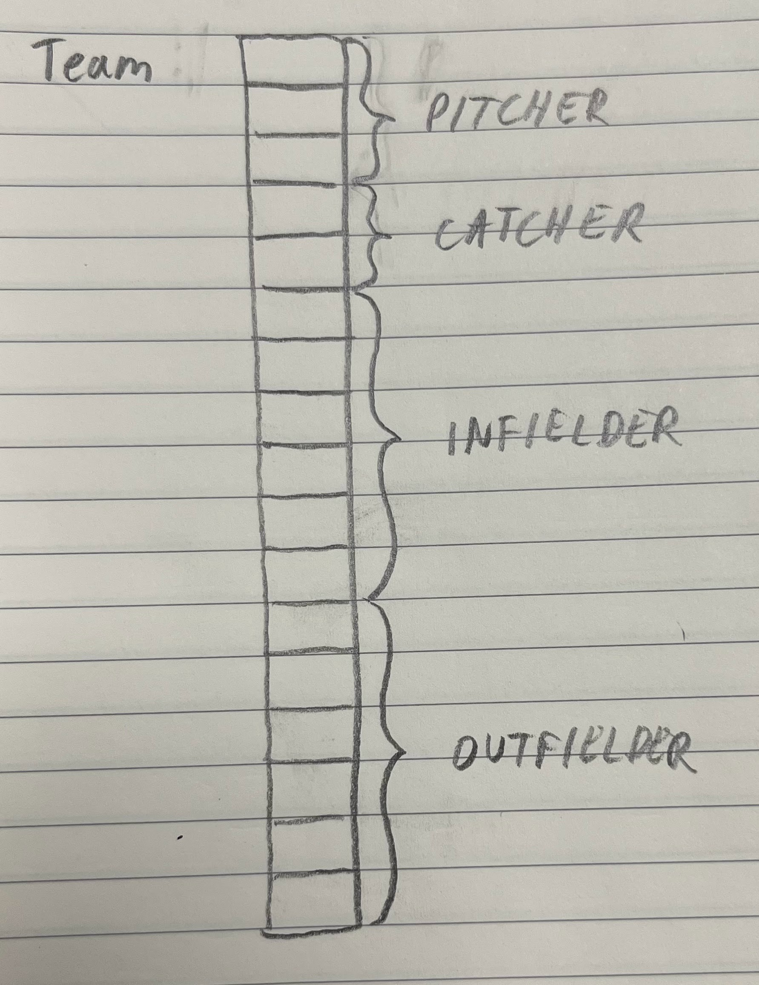
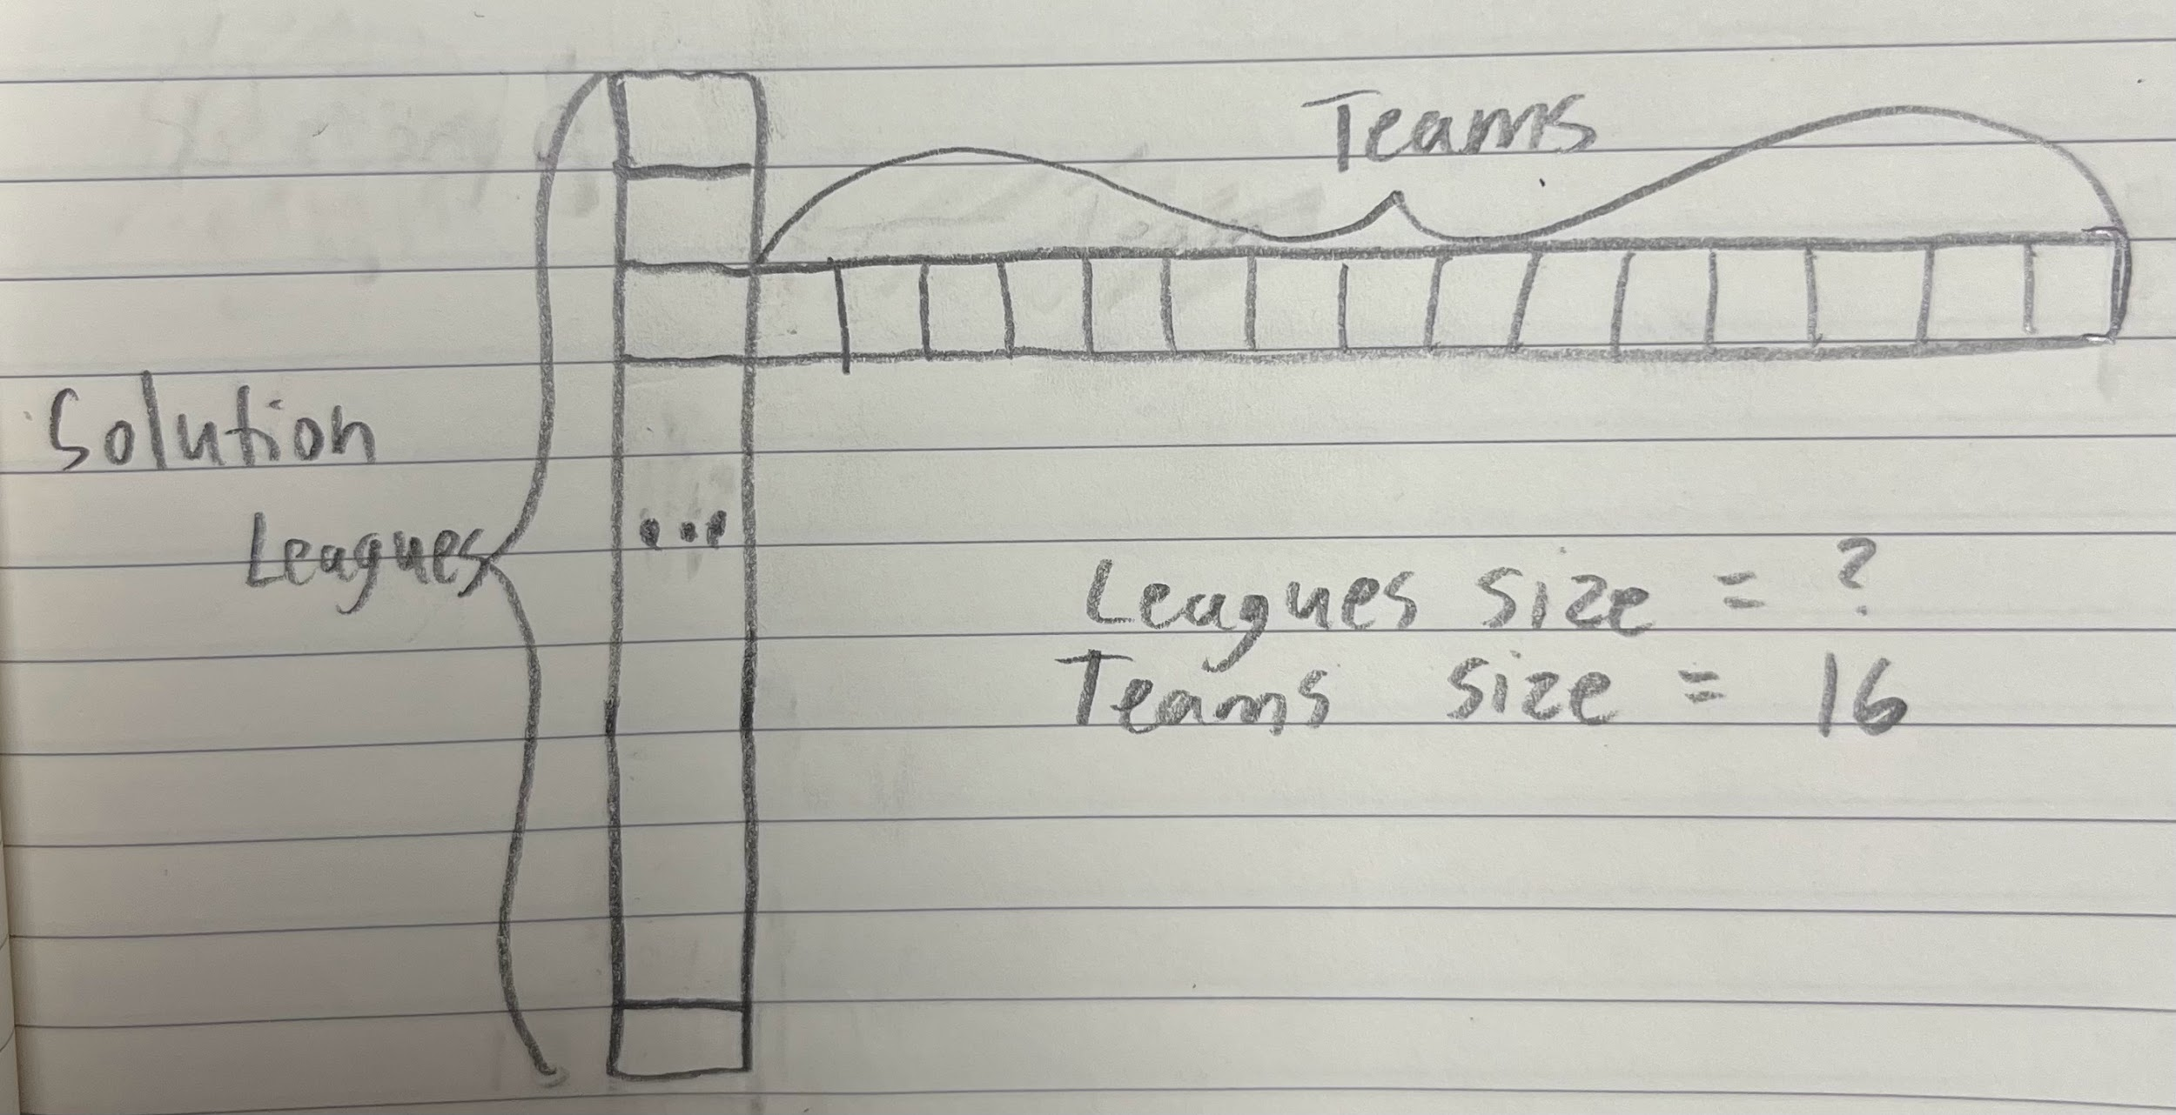

Slide 14
2. Evaluation
Each league is evaluated using the fitness function and given a league score, which will be used to determine how evenly matched the league is compared to others.

Slide 15
3. Selection
The leagues with the best scores are selected and automatically move onto the next generation, based on the fitness function. This happens because we do not want crossover or mutation to mess with our best leagues. The number of leagues that move onto the next generation are selected by the user. This is also known as elitism.

Slide 16
Generation 0
Generation 1
9
20
7
16
25
2
2
7

Slide 17
4. Crossover
A random league from the generation is chosen from the generation for two-point crossover. In this instance, a crossover is trading players between 2 random teams from the league selected.

Slide 18
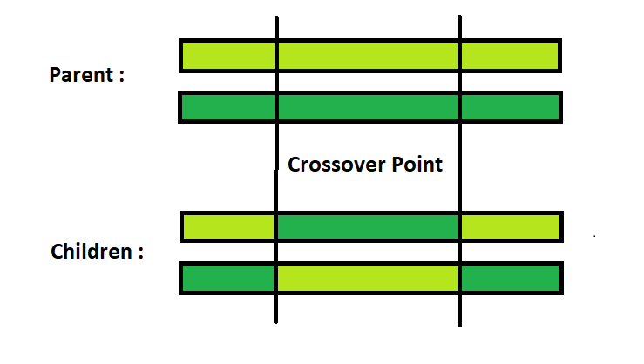
Two-Point Crossover
Two random points are chosen on each parent and the genetic material is exchanged at these points to create offspring.

Slide 19
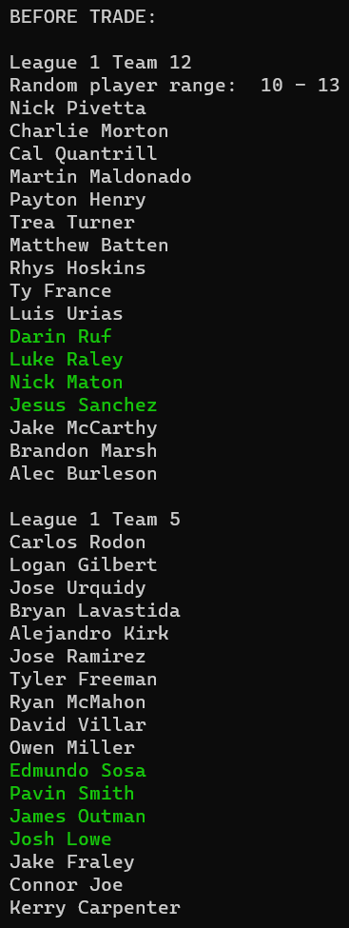
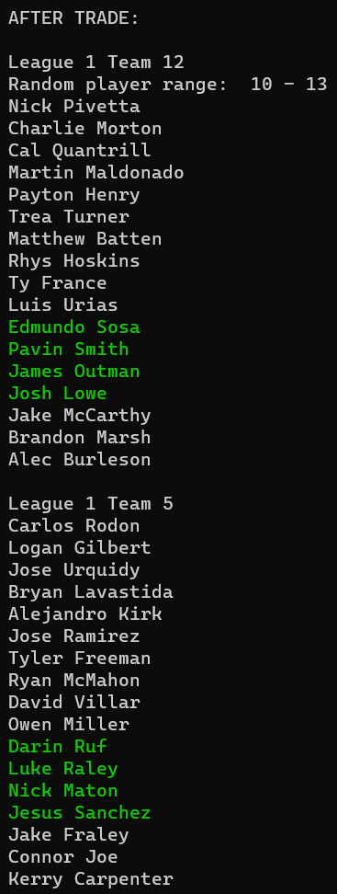

Slide 20
5. Mutation
A random mutation is introduced into the genetic information of an individual league for Random Resetting Mutation to ensure genetic diversity in the population. The number of mutations per generation is also selected by the user.

Slide 21
Random Resetting Mutation
In random resetting mutation, we select one or more random players from the current generation and change their W.A.R. values.

Slide 22
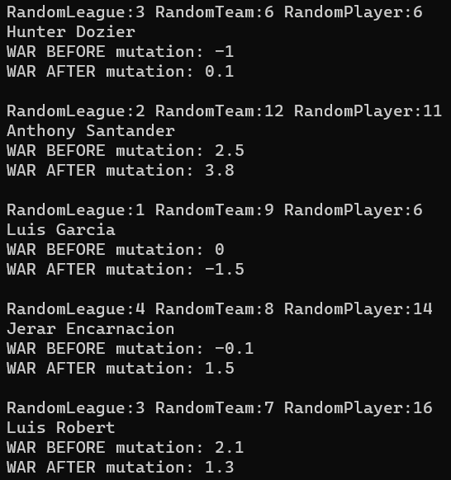

Slide 23
6. Replacement
The new offspring replace the least fit individuals in the previous population, creating a new generation.

Slide 24
Repeat!

Slide 25
7. Termination
The algorithm terminates when a stopping condition is met, such as reaching a maximum number of generations or achieving a satisfactory level of fitness.

Slide 26
My GUI

Slide 27
GUI
My goal is to present the user with decision points that are easy to find, understand and use.
My application is written in C++, so I used a Windows Form Application for my interface.

Slide 28
Exceptions

Slide 29
Exceptions
Dependent application.
Unable to customize team traits.
Bug with some output.

Slide 30
Methods

Slide 31
Methods
To start, I used a simple algorithm and built off of that.
Did not implement my GUI until I had a working version.
C++ Objects.
Testing.
Libraries.

Slide 32
Demonstration

Slide 33
Learning & Development

Slide 34
Strategies

Slide 35
Strategies
Online Resources.
Using previous notes.
Working at a good pace all semester.
Meeting with professors.

Slide 36
Extensions for Future Students

Slide 37
Extensions for Future Students
Realtime comparison features.
Running the application on compsci04.
Import capabilities.
More customization.

Slide 38
Questions?

Slide 39
Thank You!

